Slide 1
fractions
Common Denominator, Turning Mix Number into Improper Fractions, Adding and Subtracting Fractions,

Slide 2
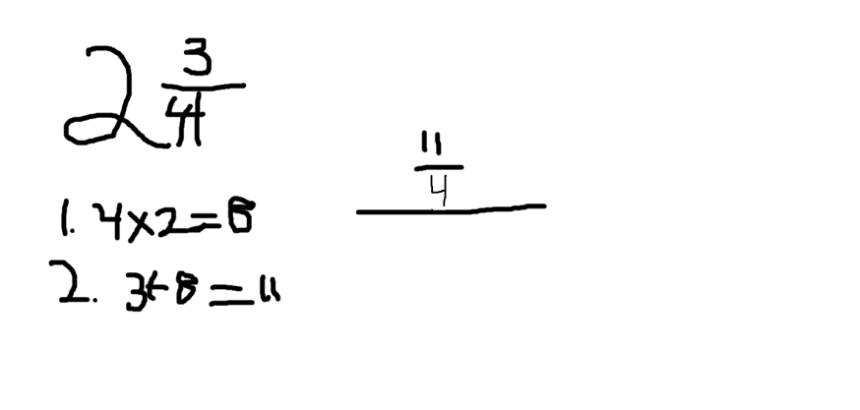
Turning mix number into improper fractions
When you turn mix numbers into improper fractions you use adding and multiplying .
First you multiply the denominator by the whole number 2x4=8
Next you add your answer by the numerator 3+8=11
Next you answer is 11/4

Slide 3
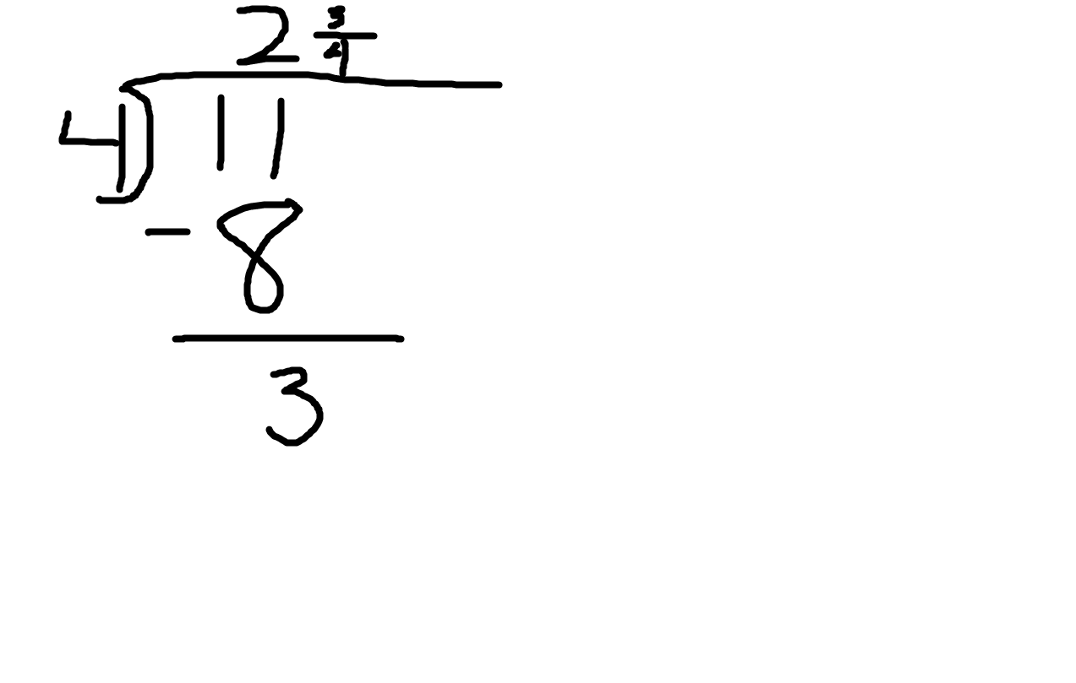
Turning improper fractions into mix number
When you turn improper fraction into mix number You
You divide your numerator 11 by your denominator 4
Next you get 2 with a remainder of 3
Your remainder is now your numerator so your answer is 2 and 3/4

Slide 4
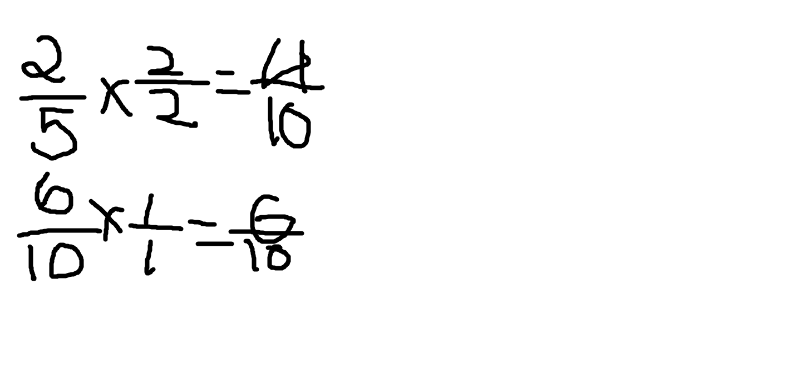
Common denominator
When finding a common denominator there is three easy step to finding a denominator
First you take your two fraction let’s say 2/5 and 6/10 and put one on top of the other
Then your multiply your two denominator 5x10=50 that your denominator
Since you multiply you denominator now you multiply 10x2=20 and 5x6=30 and those are your numerator
So your answer is 30/50 and 20/50

Slide 5
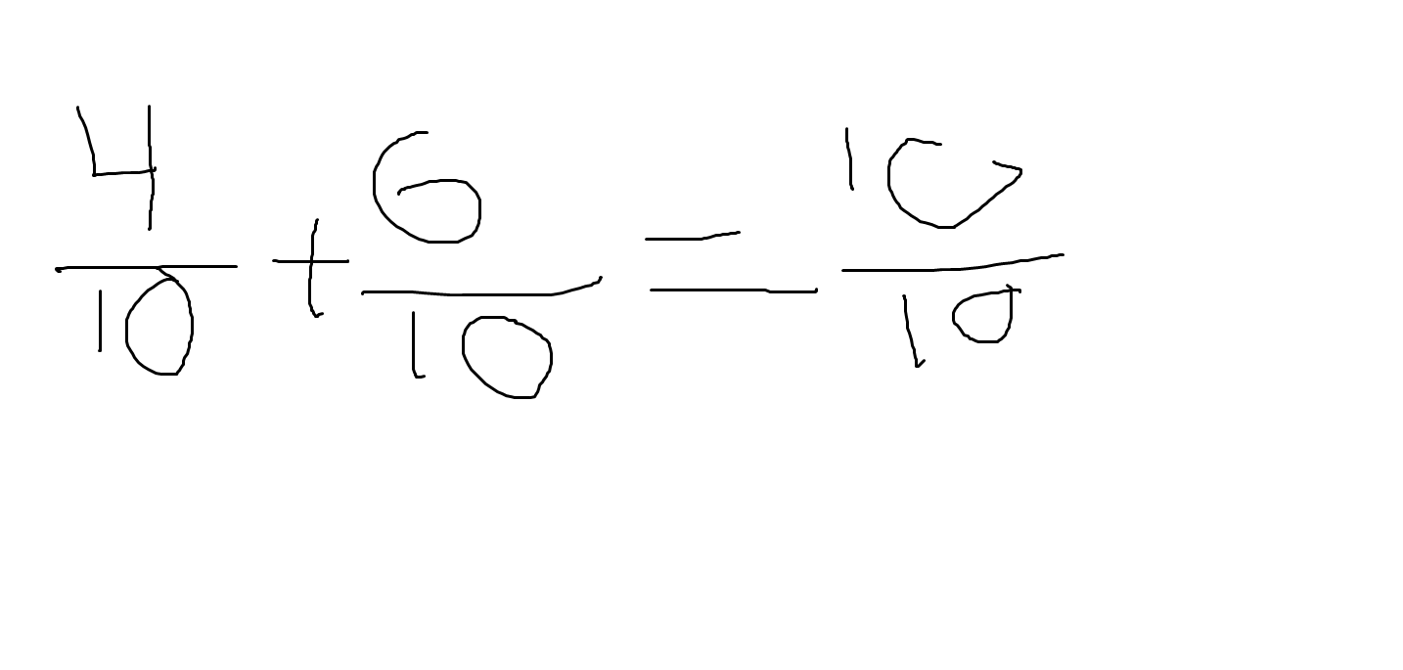
add and subtract fractions
When you add you add you always find the common denominator but we’ve done that already
First you add the numerator 4+6=10
DO NOT ADD THE DENOMONATOR
Your answer is 10/10

Slide 6
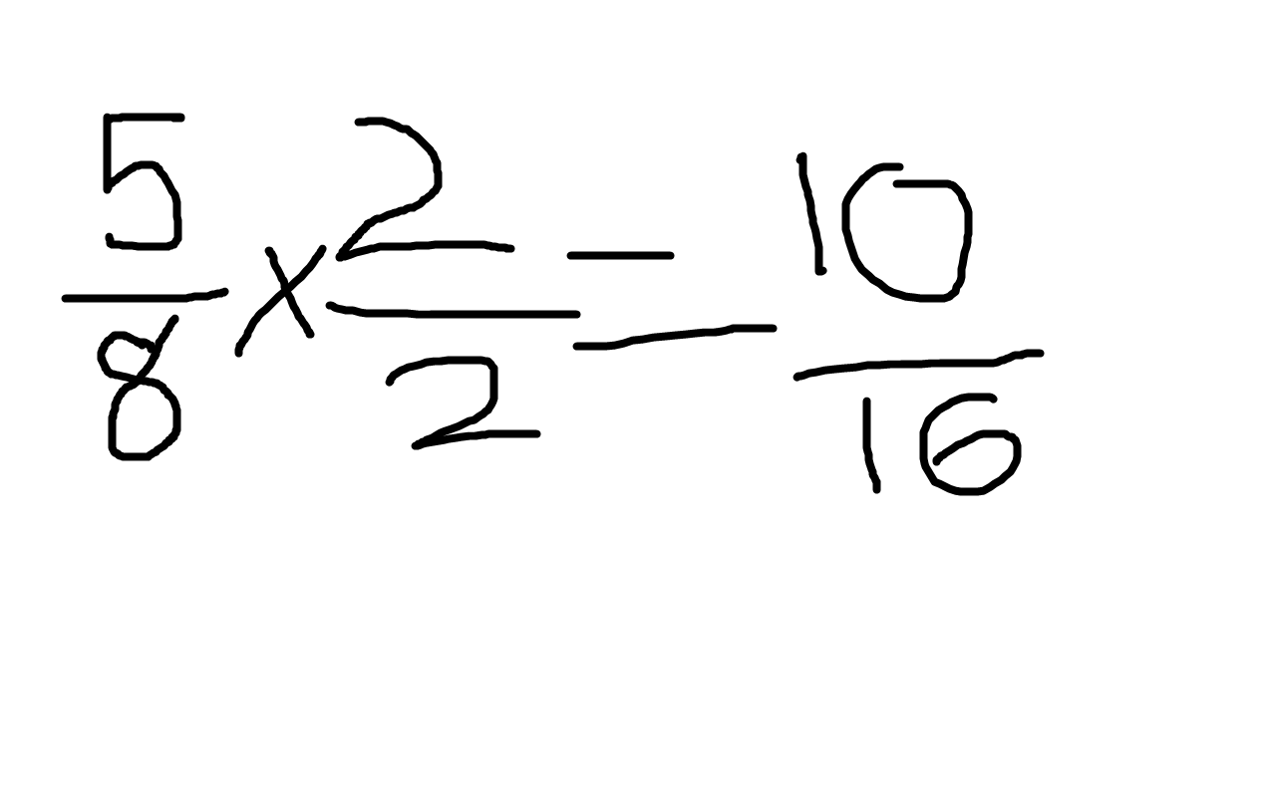
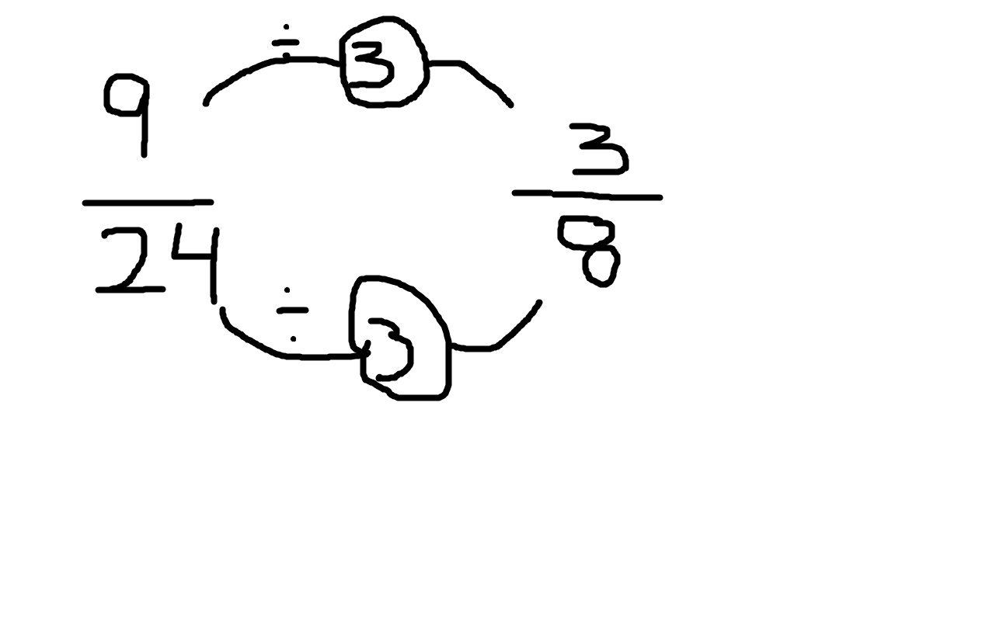
Finding Equivalent and reduced Fractions
To find equivalent fractions you
Frist you take your fraction 5/8 then you multiply by a whole number 2/2
5/6*2/2=10/16
Your answer is 10/16
To find reduced fractions you
First you take your fraction 9/24 and divide by a whole number 3/3
9/24 / 3/3= 3/8
Your answer is 3/8

Slide 7
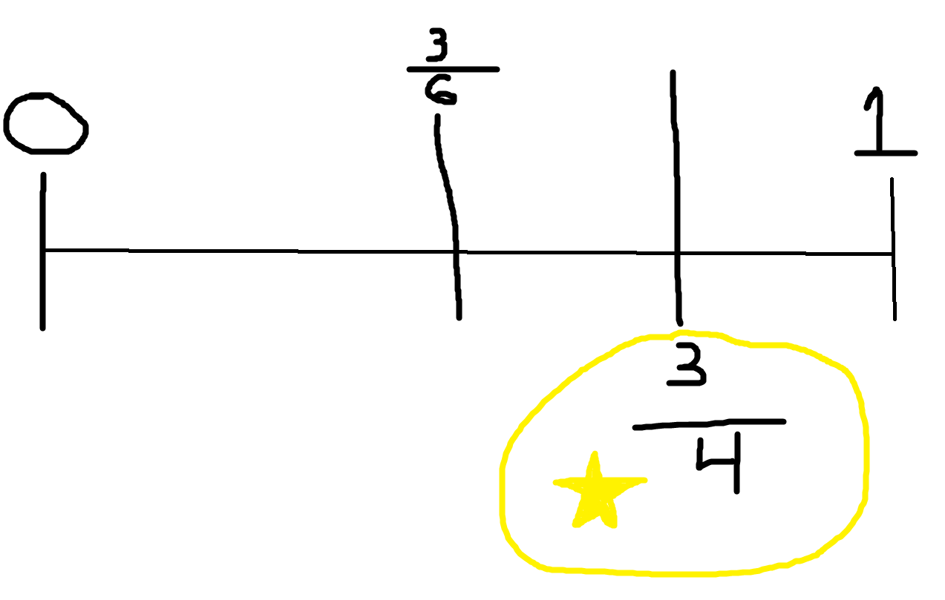
Comparing fractions
When you compare fraction you
First you make a time line
Put your fraction on the time line 3/6 and 3/4
See ones bigger
3/4>3/6

Slide 8
CREDITS
By:
Ryann

