Slide 1
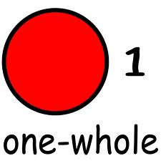
FRACTIONS in the world
BY Tyler Nagi and Aidan Riley
In class Ms. Kilpatrick's class A005

Slide 2
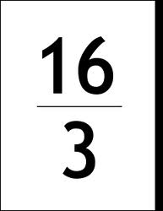
Improper Fractions
An improper fraction is when bigger number is on top and the denominator is smaller. You can work with numbers easier with improper fractions.

Slide 3
Mix numbers
It easy to tell how many whole numbers are in a fraction. It also helps when your adding another number that has a whole number or a fraction.

Slide 4
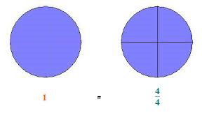
Whole numbers
Whole numbers are fractions where the numerator and denominator are the same. Example: 4/4 is a whole number. Which means 4/4 is one. Also, if the numerator can be divided evenly by the denominator, the fraction equal's a whole number. Example : 21/3=7 with 0 remainder but still equals a whole number.

Slide 5
Adding fractions
One of the first things you have to add fraction you need to find a common denominator . I bet you are asking do I find a common denominator. The way you find a common denoanater is you use a muiltybuls in a table when you find the denominator you have common denominator then it is really easy.

Slide 6
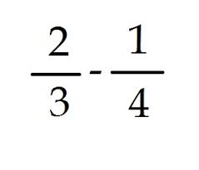
Subtracting FRACTIONS
The first thing you need do is you need to find the common detonator. The way fin a common detonator is you multiply the detonator by 2 until it equles the same thing.

Slide 7
Web sites we use!!!
http://www.abcteach.com/
http://www.mathblaster.com/
http://www.singinghedgehog.co.uk/SHG/SHGMIfrac4.htm

